Slide 1
Stories We Tell (and the Machines Retell)
Cross-Cultural Narrative Analysis using LLMs
NLP Course Final Project - University of Milan
Student: Shakiba Fotouhi
Prof. Alfio Ferrara

Slide 2
Introduction
Narratives
A narrative is the telling of some actual or fictitious sequence of connected events to an audience, by a narrator in some cases (and in all cases of written narratives). Written forms: personal essays, fairy tales, short stories, novels, plays, screenplays, autobiographies, and histories—even news stories have a narrative. Narratives may be a sequence of events in chronological order or an imagined tale with flashbacks or multiple timelines.
Narrative Analysis
Structural Analysis | Semantic Analysis
what is the story made of, and how is it organized? | what does the story mean, and how does it produce meaning?

Slide 3
Define the project questions and methodology
Can narrative structures be identified and compared across cultures by modeling stories as sequences of events?
Do large language models preserve these structures when generating retellings?
Can large language models work as cultural translators? (mimicking the structure for another culture’s narratives)

Slide 4
Define the project question and methodology
Data
Human Written narratives
LLM Generated narratives in the same culture
LLM Generated narratives cross culture
Methods
How to convert narratives to graphs - SVO
Define comparison metrics that capture structural aspects
Results
Human Narratives in different cultures compariosn
Human vs LLM narrative comparison in the same culture
Human vs LLM narrative comparison in the other cultures

Slide 5
Road Map
1
2
3
Define the project question and methodology
Choose the cultures and collect the narratives
Ask LLMs to generate the narratives in the same and cross culture
4
5
6
Convert narratives into graphs with defined method
Compare the graphs of human written and machine written narratives
Define Analyzing Methods and Metrics

Slide 6
Choose the cultures and Collect the stories
Culture | Average Event per Story | Average Words per Story | Average Sentence per Story
Native American | 390.7 | 3030.0 | 80.9
German | 225.1 | 1557.8 | 73.5
Persian | 457.6 | 3280.0 | 150.1
Choose the cultures
Collect the human written narratives
German
Native American
Persian
Personally collected 10 narratives per culture from the web
Data
Human Written narratives
LLM Generated narratives in the same culture
LLM Generated narratives cross culture

Slide 7
Road Map
1
2
3
Define the project question and methodology
Choose the cultures and collect the narratives
Ask LLMs to generate the narratives in the same and cross culture
4
5
6
Convert narratives into graphs with defined method
Compare the graphs of human written and machine written narratives
Define Analyzing Methods and Metrics

Slide 8
Ask LLMs to generate the stories in the same and cross culture
Same Culture narrative generation prompt
LLM Model
Output
System Prompt:
"You are a careful literary reteller. "
"Retell stories in modern English while preserving characters and the sequence of key events. "
"Do not add commentary, explanations, headings, or bullet points. Output only the retold story."
Task:
Retell the story below in modern English while preserving the main characters and the sequence of key events.
Keep the cultural setting and narrative flavor consistent with its origin culture.
Keep length roughly similar to the original (±20%).
Avoid summarizing: keep the events.
Output format:
- Output ONLY the retold story text (no analysis).
- Do NOT include the original story.
Chat GPT: gpt-4.1-mini
10 txt files per culture
Story IDs as name

Slide 9
Ask LLMs to generate the stories in the same and cross culture
Cross Culture narrative generation prompt
LLM Model
Output
System Prompt:
You are a careful literary reteller adapting stories across cultures.
Always write the output in English only Do not switch languages.
Preserve the main sequence of events, main characters, and causal structure.
Adapt setting, imagery, symbols, and cultural references to the target culture.
Keep the retelling close in length to the original.
Output only the retold story text.
Task: "Retell the following story as if it originated in target culture folklore.
Important constraints:
- Preserve the main sequence of events.
- Preserve the main characters and causal structure.
- Write the entire retelling in English only.
- Adapt the setting, imagery, symbols, and cultural references so the story feels natural in target culture folklore.
- Keep the retelling roughly the same length as the original (±20%).
- Output only the retold story text.
Chat GPT: gpt-4.1-mini
10 txt files per culture
Story IDs as name
Get target culture by defining culture map
Key | Value
German | Persian
Persian | Native American
Native American | German

Slide 10
Road Map
1
2
3
Define The Project Question and Methodology
Choose the cultures and Collect the stories
Ask LLMs to generate the stories in the same and cross culture
4
5
6
Define Analyzing Methods and Metrics
Convert narratives into graphs with defined method
Compare the graphs of human written and machine written stories

Slide 11
Convert narratives into graphs with defined method
Methods to convert narratives into graphs
Event Extraction / Event Graphs
Named Entity Recognition (NER) + Relation Extraction
Coreference Resolution
Event Extraction / Event Graphs
Semantic Role Labeling (SRL)
Dependency Parsing
Knowledge Graph Construction
Character Interaction Networks
Discourse / Rhetorical Structure Trees → Graphs
LLM-based Extraction (Modern Approach)
Extract events (who did what to whom, when, where) as nodes
Connect events via temporal, causal, or participatory edges
Results in an event chain or story graph
Event extraction using Subject-Verb-Object (SVO)
Example
Subject: The entity performing the action (e.g., agent, person, organization).
Verb: The action or process, often acting as the event trigger.
Object: The entity receiving the action, or the target/theme of the event.
Triple Generation: (Subject, Verb, Object) tuples.
Event → Graph
Nodes = events (subject–verb–object)
Edges = temporal order
"sent_id": 3,
"subj": "gardener",
"verb": "set",
"obj": "son",
"label": "gardener | set | son",
"sentence": "The gardener set his eldest son to watch; but about twelve o\u2019clock he fell asleep, and in the morning another of the apples was missing."

Slide 12
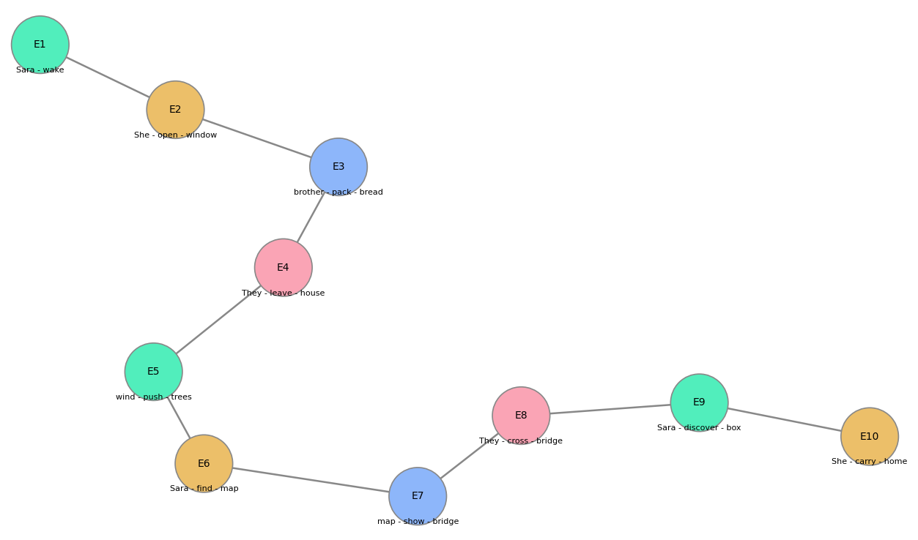
Convert narratives into graphs with defined method
Convert events to graphs
Simple Example
Sara woke up early in the village.
She opened the wooden window and saw dark clouds.
Her brother packed some bread and a small knife.
They left the house and walked toward the forest.
A cold wind pushed the trees from side to side.
Sara found a map under a broken stone.
The map showed a hidden bridge near the river.
They crossed the bridge and entered a silent cave.
Inside the cave, Sara discovered a golden box.
She carried the box home and told her family the story.

Slide 13
Human VS LLM Generated In the same cultures
Human Graphs Summary
LLM Graphs Summary
Culture | Avg word count | Avg. events | Avg events per 100 words
German | 2020 | 78.8 | 3.842024
Native American | 1557.8 | 72.3 | 5.225317
Persian | 3280 | 134.7 | 4.294507
Culture | Avg word count | Avg. events | Avg events per 100 words
German | 1212.3 | 84.6 | 6.973664
Native American | 1017.3 | 66.6 | 6.650739
Persian | 1259.7 | 84.3 | 6.345408

Slide 14
Human VS LLM Generated cross culture
Human Graphs Summary
LLM Graphs Summary
Culture | Avg word count | Avg. events | Avg events per 100 words
German | 2020 | 78.8 | 3.842024
Native American | 1557.8 | 72.3 | 5.225317
Persian | 3280 | 134.7 | 4.294507
Culture | Avg word count | Avg. events | Avg events per 100 words
German | 1069.2 | 63.4 | 5.874818
Native American | 908.9 | 50.4 | 5.497669
Persian | 897.1 | 50 | 5.445879
Key | Value
German | Persian
Persian | Native American
Native American | German

Slide 15
Road Map
1
2
3
Define The Project Question and Methodology
Choose the cultures and Collect the stories
Ask LLMs to generate the stories in the same and cross culture
4
5
6
Define Analyzing Methods and Metrics
Convert narratives into graphs with defined method
Compare the graphs of human written and machine written stories

Slide 16
Define Analyzing Methods and Metrics
Structural Metrics
Node compression ratio Edge compression ratio Longest path ratio Graph density difference Average degree difference
Semantic Metrics
Sentence embeddings (SBERT) Cosine similarity
Graph Metric
Graph Edit Distance

Slide 17
Road Map
1
2
3
Define The Project Question and Methodology
Choose the cultures and Collect the stories
Ask LLMs to generate the stories in the same and cross culture
4
5
6
Define Analyzing Methods and Metrics
Convert narratives into graphs with defined method
Compare the graphs of human written and machine written stories

Slide 18
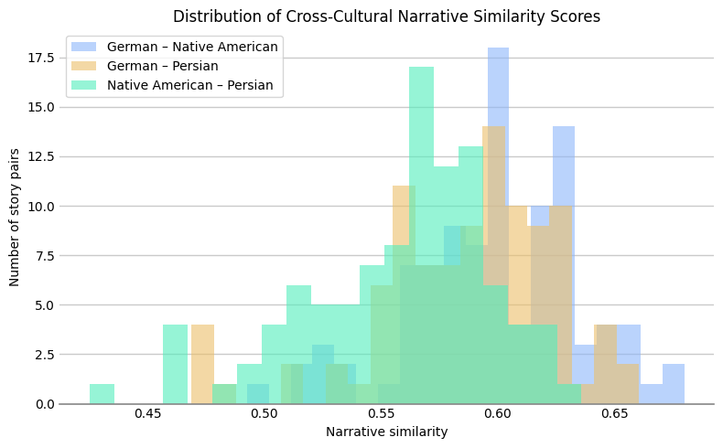
Compare the graphs of human written and machine written stories
Similarity between stories from different cultures (Human Narratives)
Model: all-MiniLM-L6-v2
A semantic event-based similarity
compare narratives across cultures by matching their extracted SVO events using embeddings and cosine similarity.

Slide 19
Structural Metrics
Same Culture
Consistent Compression :
Generated fewer events, connections and shorter narrative paths
The stories became simpler and more linear

Slide 20
Structural Metrics
Cross Cultures

Slide 21
Manual Analysis
HANSEL AND GRETEL story re-tolled by LLM in the Persian culture
Names
Hansel → Bahram
Gretel → Laleh
Stepmother → Farzaneh
Cultural Setting
Original: German/European forest.
Persian version: Vast Persian woodlands, desert-like elements, references to cypress and dunes.
Objects and Imagery
Pebbles → Pearls (precious and culturally resonant in Persian context).
Bread and cakes → Honeyed bread, saffron cakes, dates (more Persian/Islamic culinary references).
Religious/Cultural References
European: God is invoked for help.
Persian: Anahita, goddess of mercy, is invoked instead of a monotheistic God.
Includes poetic and mystical references: wind, desert, moonlit swan.
Storytelling Style
Persian version uses more poetic language, metaphor, and elaborate description.
Dialogue often includes cultural expressions and imagery (e.g., “moonlit swan,” “stars of Isfahan”).
Magical Helpers
European: Duck as a simple animal helper.
Persian: White duck described as a blessing from river spirits, tying into Persian mythology.

Slide 22
Graph edit distance: Human narratives vs LLM in the same culture
GED represents strict structural similarity
SVO noise
Difference in event granularity and wording, which increases edit distance

Slide 23
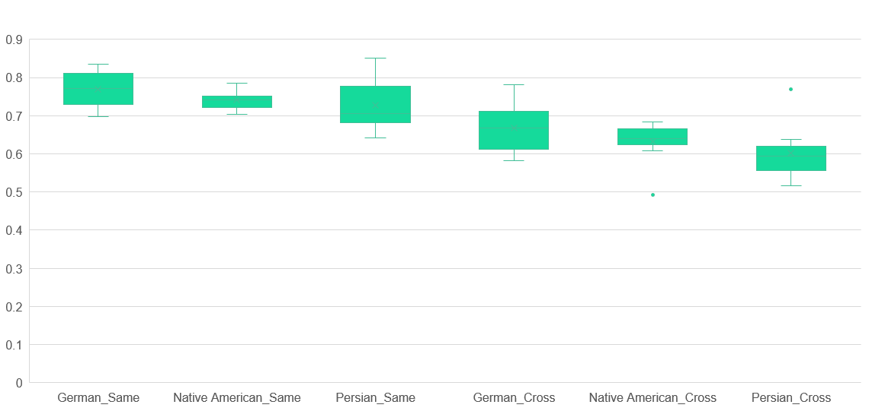
Semantic Metrics
Semantic similarity (continuous score 0–1)
computed using embeddings (SBERT + cosine similarity)
Despite structural compression semantic similarity remains high
The meaning of stories is largely preserved
Cross- cultural retellings introduce more variation and distortion.
Suggesting that adapting to another culture story is a more difficult task

Slide 24
Interpretation: What Do These Results Mean?
The tested model as representative of LLMs:
Semantic preservers
Structure simplifiers
Able to preserve majority of structure
Removed less important events Whilst keeping the main storyline
Are LLMs Cultural Translators?
Partially YES
Preserve core meaning
Maintain main narrative flow
Lose cultural nuances
Compress storytelling richness
Also depends on what aspects of culture you look for, LLMs are approximate cultural translators, not perfect ones

Slide 25
Limitations
Small dataset (30 stories) –Already translated – cultural simplification
Only one LLM model test
Event extraction noise
Graph simplification assumptions
Limited cultural diversity
Ignoring other aspects of cultural effects

Slide 26
Thank you for your attention

